Slide 1
555 Timer

Slide 2

555 Timer
Versatile IC, have so many application
8
5KΩ
6
+
THRESHOLD
5
-
7
DISCHARGE
CONTROL
S
Q
5KΩ
+
Q
3
R
OUTPUT
2
4
TRIGGER
-
5KΩ
RESET
1
GROUND

Slide 3







Monostable Operation
8
R
7
4
8
6
5kΩ
R
7
3
+
C
-
555
S
Q
5kΩ
3
6
5
R
Q
2
+
TRIGGER
-
2
1
0.01 µF
5kΩ
C
1
TRIGGER
TRIGGER
0
THRESHOLD
W = 1.1RC
0
OUTPUT

Slide 4







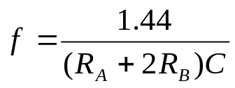


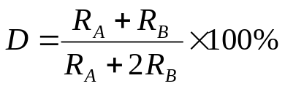


Astable Operation
8
7
4
8
7
3
5kΩ
6
+
6
555
-
S
Q
5
5kΩ
3
2
0.01 µF
R
Q
1
C
+
C
2
-
5kΩ
1

